Slide 1

GitHub Actions Best Practices
Santosh Yadav
@SantoshYadavDev

Slide 2



About me
Senior Software Engineer @Celonis
Co-host This is Tech Talks
GDE Angular, Nx Champion
GitHub Star
Co-Founder This Is Learning
@SantoshYadavDev
Santosh Yadav
@SantoshYadavDev

Slide 3
What is GitHub Actions

Slide 4
Build tool to Automate your workflows

Slide 5
Run workflow on major OS mac/windows/linux
Run workflows on any GitHub event
Automate workflows
‹#›

Slide 6
Supports Matrix
Write Custom Actions
‹#›

Slide 7
Best practices starts from the day you create your organization

Slide 8
Best practices starts from day one.
Be proactive.
Best practices changes with time.

Slide 9


Slide 10
Give access to teams not individuals

Slide 11
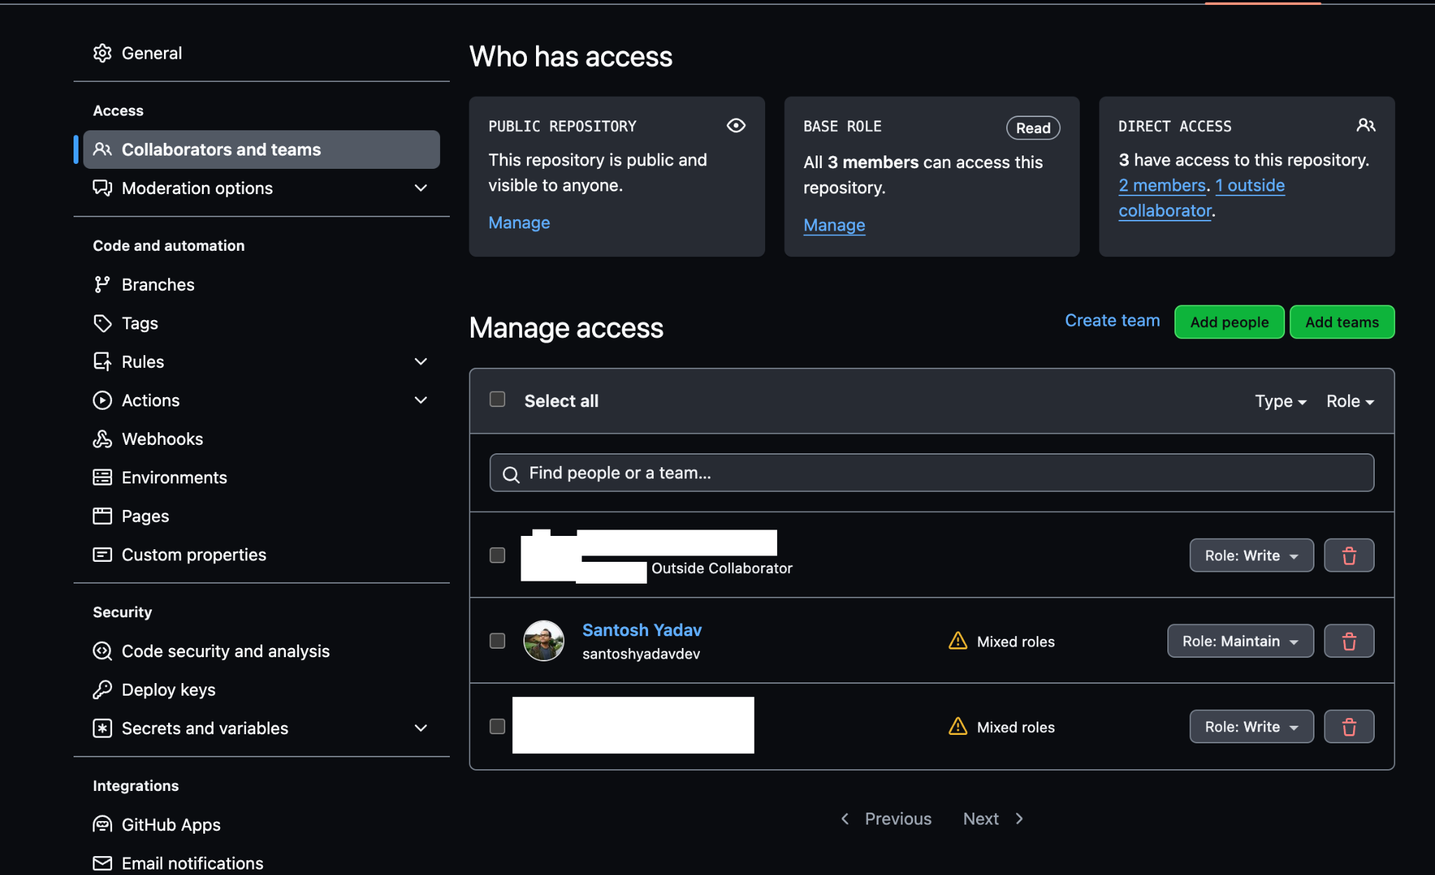

Slide 12
Configure Branch Protection Rules

Slide 13
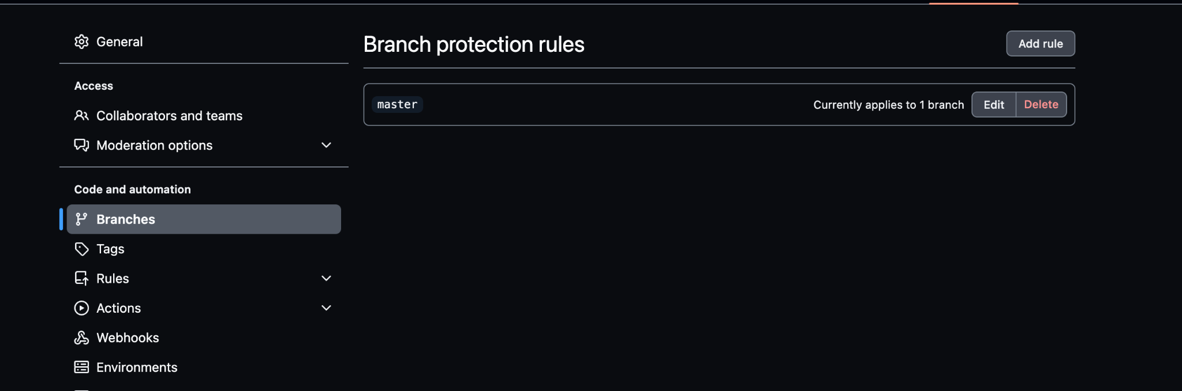
Notes:
Go to https://github.com/uiuniversal/ngu-carousel/settings/branch_protection_rules/new
z

Slide 14
Use Trusted Actions

Slide 15
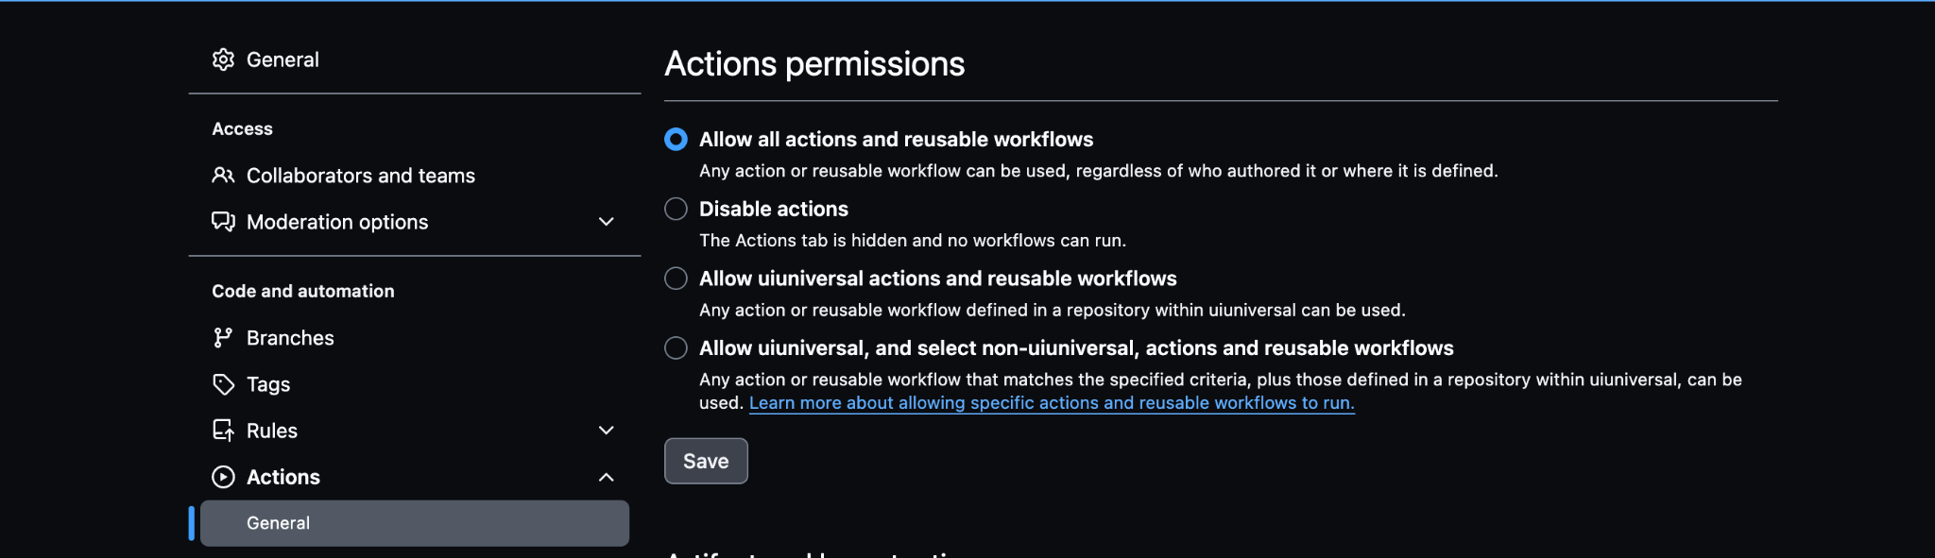

Slide 16
Use Specific versions of Actions with SHA-1

Slide 17
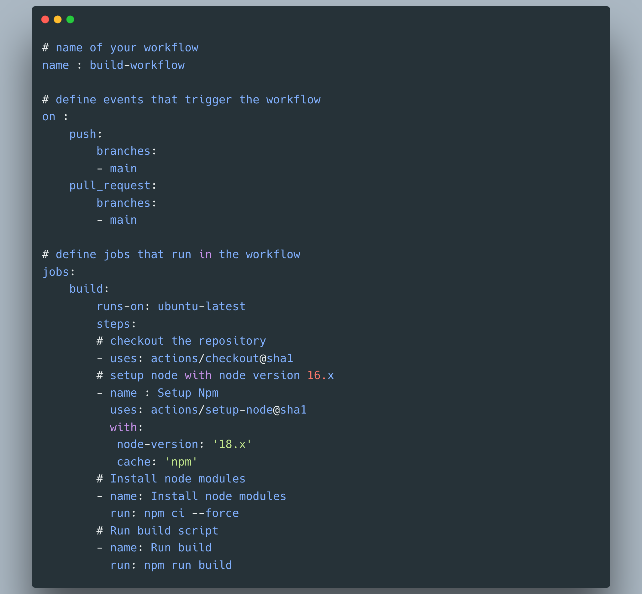

Slide 18
Audit 3rd party Actions.

Slide 19
Be careful with outside collaborators

Slide 20
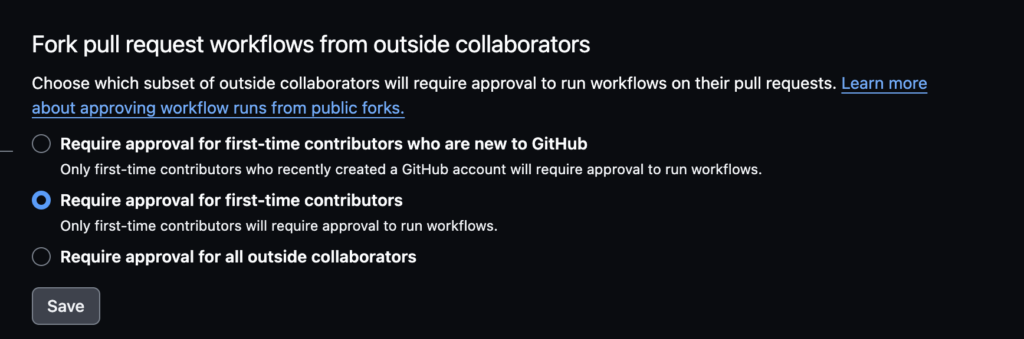

Slide 21
Follow principle of least privilege for GITHUB_TOKEN

Slide 22
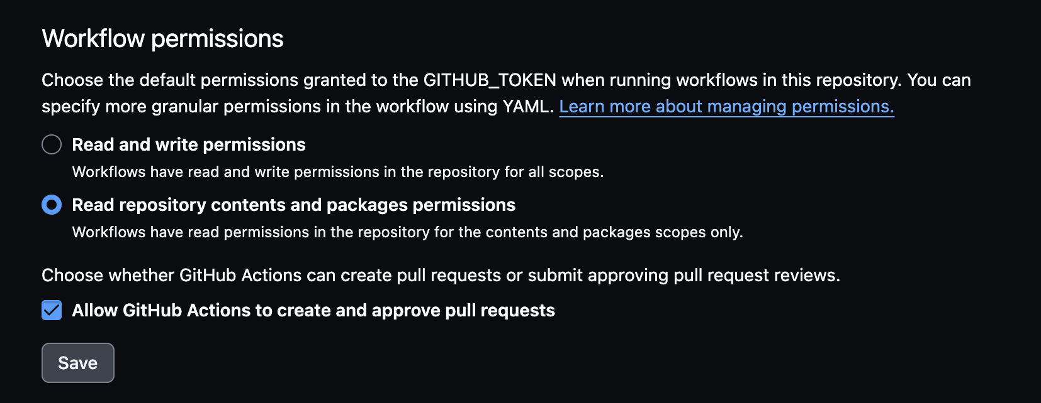

Slide 23
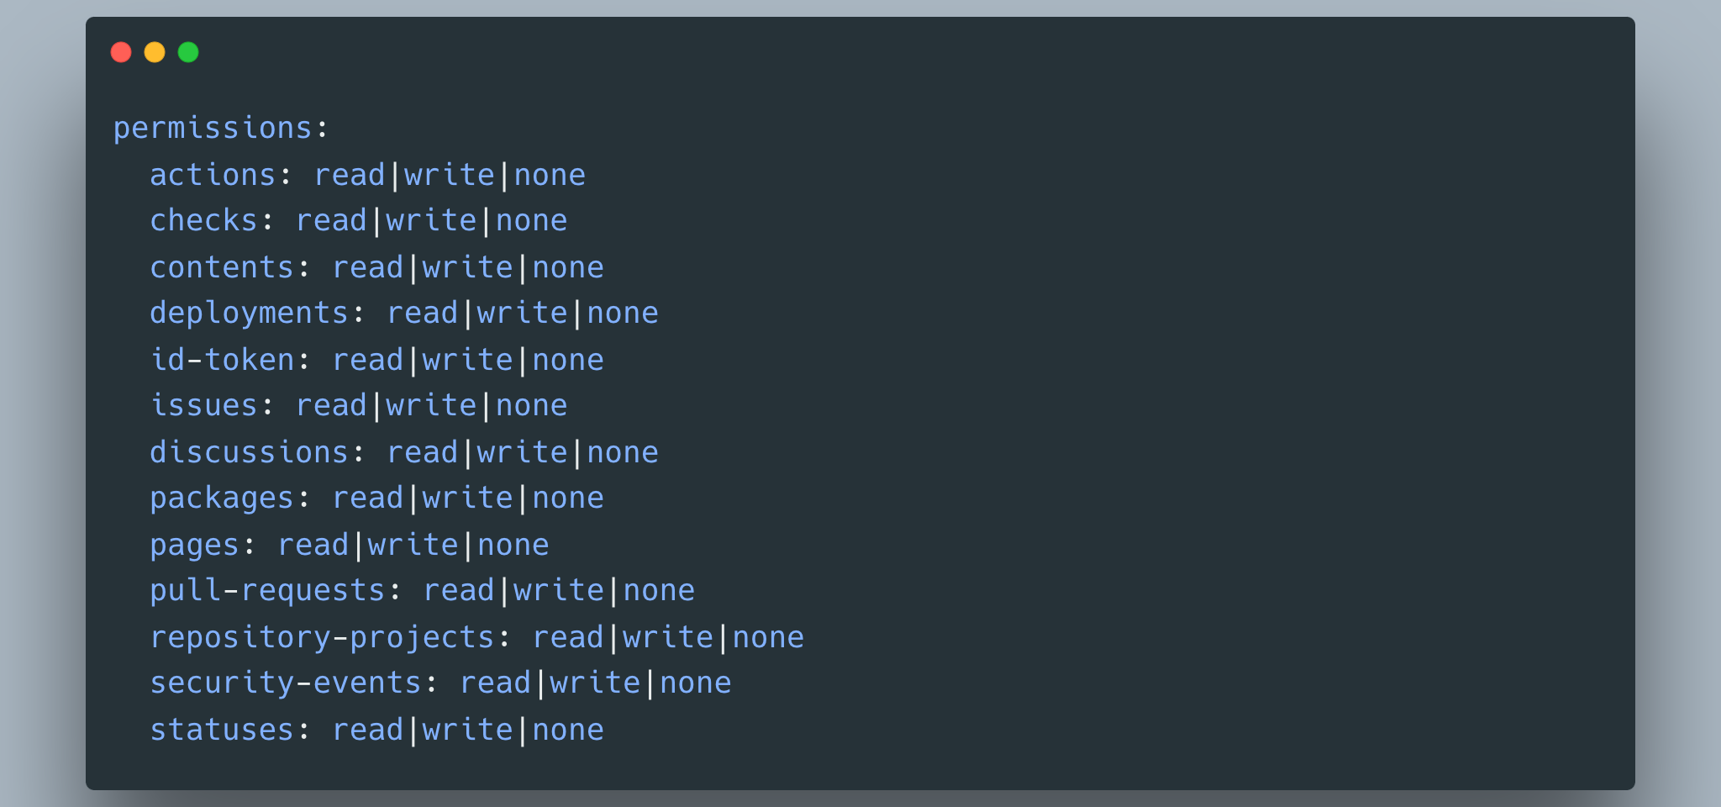

Slide 24
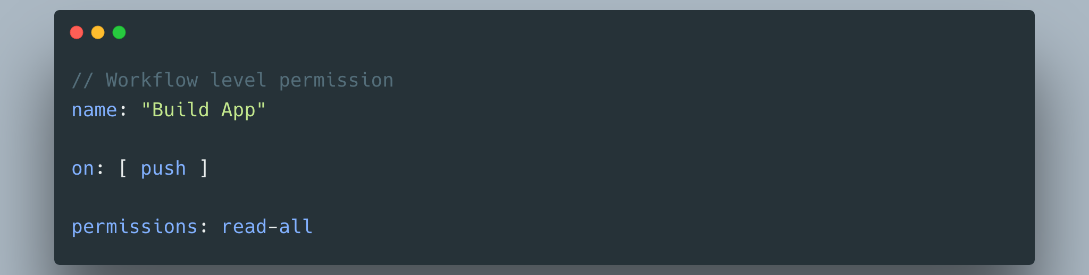

Slide 25
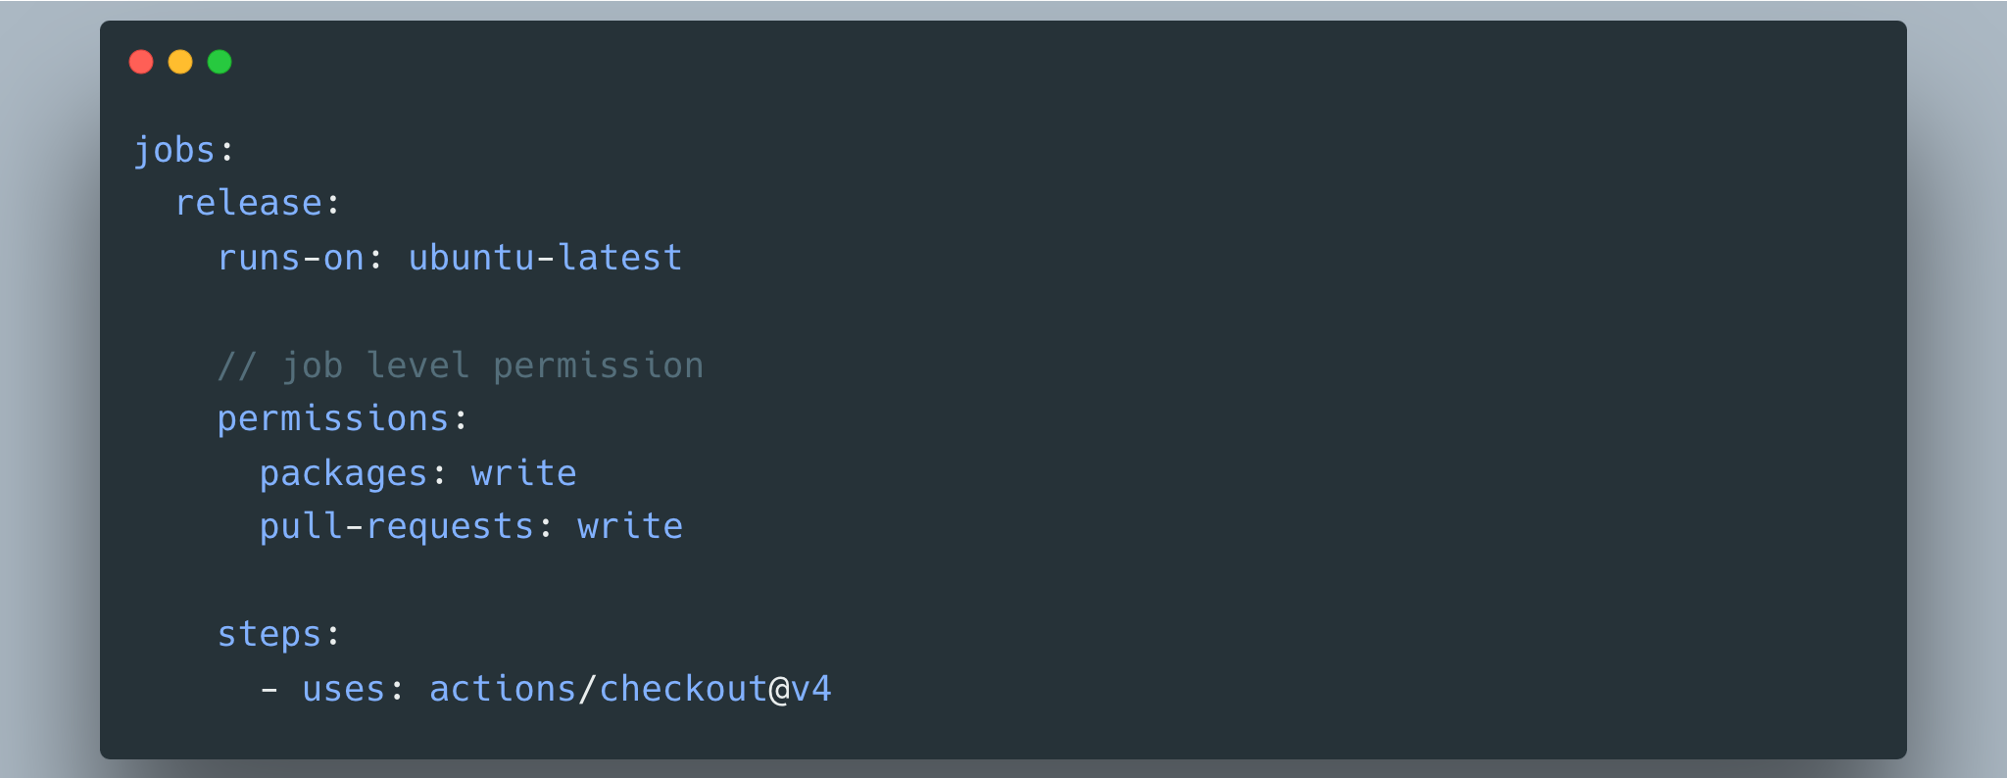

Slide 26
Create environment level secrets.

Slide 27
Personal Access Token

Slide 28
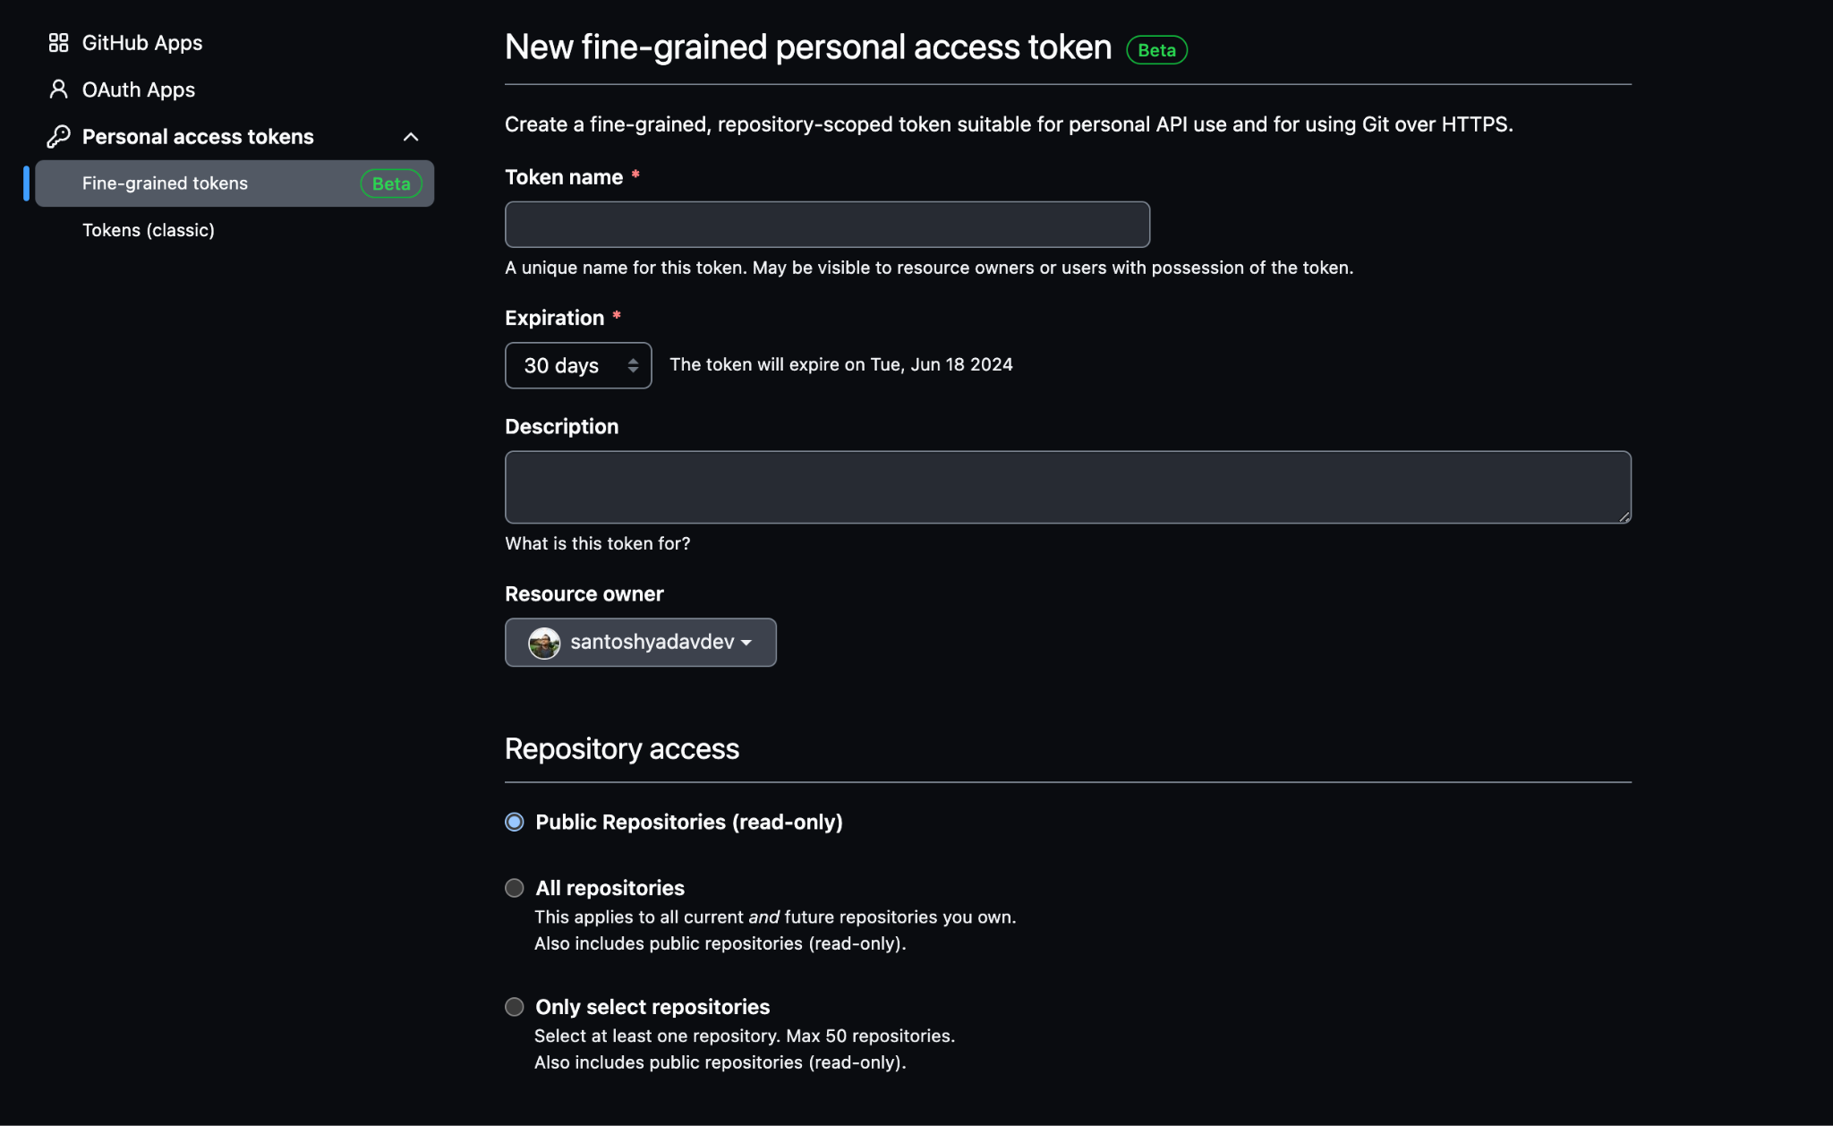

Slide 29
Enable 2FA and SSO

Slide 30
Register all secrets.

Slide 31
Rotate tokens and do planned audits.

Slide 32
Monitor permission for your action

Slide 33
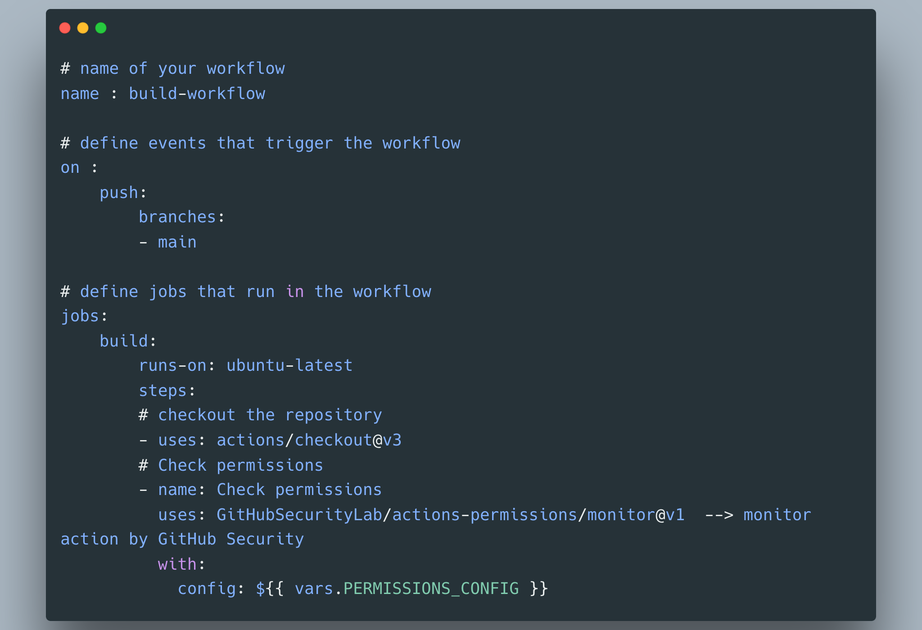

Slide 34
Use GitHub token permissions Monitor and Advisor actions
https://github.com/GitHubSecurityLab/actions-permissions
https://github.com/GitHubSecurityLab/actions-permissions/tree/main/advisor

Slide 35
References
https://adnanthekhan.com/
https://0xn3va.gitbook.io/cheat-sheets/ci-cd/github/actions#github-runner-registration-token-disclosure
https://securitylab.github.com/research/github-actions-building-blocks/
https://docs.github.com/en/actions

Slide 36
Thanks to my GitHub Sponsors
Cometa.rocks
Sunil
Darshan
Umair
Anand

Slide 37
Thank you
Santosh Yadav
@SantoshYadavDev

